Slide 1


A
Presentation on
‘Smart Yoga Mat Using IOT For Real-Time Posture Monitoring;’
by
Paper ID:- CSE05
Name:- Priti Hanmant Deshmukh
Pranjali Bajirao Panwal
Shreya Rajendra Patil
Pranil Gorakh Patil
Affiliation:- AGTI’s DACOE , KARAD
at
INTERNATIONAL CONFERENCE
on
EMERGING TECHNOLOGIES, INNOVATION AND SUSTAINABLE DEVELOPMENT(ICETIS-2026)
(23rd March – 24th March 2026)
Organized by
Dr. Ashok Gujar Technical Institute’s
Dr. Daulatroa Aher College Of Engineering , Karad
Jointly with
CTIF Global Capsule (CGC), Denmark

Slide 2
CONTENT OF THE PRESENTATION
Introduction to Topic
Review of Literature
Gap Analysis & Problem Statement
Objectives & Methodology
Results & Discussions
Conclusions & Future Scope
References

Slide 3
INTRODUCTION TO TOPIC
Yoga is widely practiced for improving physical health and mental well-being.
Many people now prefer practicing yoga at home due to busy lifestyles.
Beginners often perform poses incorrectly without proper guidance.
Incorrect posture can reduce effectiveness and cause physical strain.
The proposed Smart Yoga Mat using IoT helps users practice yoga correctly by monitoring posture and providing feedback.

Slide 4
REVIEW OF LITERATURE
Author & Year | Title | Technology Used | Advantages | Disadvantages | Performance Values
Long & Jo (2019) | Development of Yoga Posture Coaching System Using Transfer Learning | Deep Learning, MobileNet, Computer Vision | Accurate pose classification, automated yoga training support | Requires high-quality image dataset and good lighting | Accuracy ≈ 91%, Precision ≈ 89%, Recall ≈ 88%
Sun (2019) | RFitness: Smart Yoga Mat for Fitness Posture Detection | RFID Sensors, IoT | Preserves user privacy, sensor-based posture monitoring | Cannot capture full body posture | Accuracy ≈ 85%, Response Time ≈ 150 ms
Anusha et al. (2021) | Embedded-Based Smart Yoga Mat for Yoga Activity Monitoring | Force Sensitive Resistors, Embedded System | Detects body pressure and balance effectively | Limited pose recognition capability | Accuracy ≈ 88%, Precision ≈ 86%
Gadhvi et al. (2021) | PosePilot: Edge-AI Posture Correction System | LSTM Neural Network, Edge AI | Fast real-time feedback with low latency | Requires powerful edge devices | Accuracy ≈ 92%, Latency ≈ 80 ms
Sharma et al. (2020) | Computer Vision Based Yoga Pose Recognition | MediaPipe, OpenCV, Pose Estimation | Accurate body landmark detection and angle calculation | Performance affected by camera placement | Accuracy ≈ 90%, Precision ≈ 88%

Slide 5
GAP ANALYSIS & PROBLEM STATEMENT
Existing System | Limitation | Proposed Solution
Traditional yoga practice without supervision | Users cannot identify whether posture is correct | Automated Smart Yoga Mat system for home practice
Home yoga practice | Users may perform poses incorrectly without feedback | Real-time posture monitoring and correction
Camera-based posture monitoring systems | Accuracy affected by lighting and camera placement | Pose detection using MediaPipe body landmarks
Basic fitness tracking devices | Track activity but cannot analyze yoga poses | Joint angle analysis to identify correct posture
Existing posture monitoring systems | Do not provide immediate posture correction feedback | System provides real-time feedback through screen alerts and voice guidance

Slide 6
PROBLEM STATEMENT
Many people practice yoga at home without proper guidance. As a result, they may perform poses incorrectly, which can reduce exercise effectiveness or cause physical strain.
Therefore, a Smart Yoga Mat system is needed to monitor body posture and provide real-time feedback to help users maintain correct alignment during yoga practice.

Slide 7
OBJECTIVES AND METHODOLOGY
Objectives:
To design a Smart Yoga Mat using IoT with a laptop for real-time posture analysis.
To monitor yoga session duration and pose accuracy.
To provide real-time feedback and performance tracking through the laptop application.
To improve yoga practice and overall health.

Slide 8
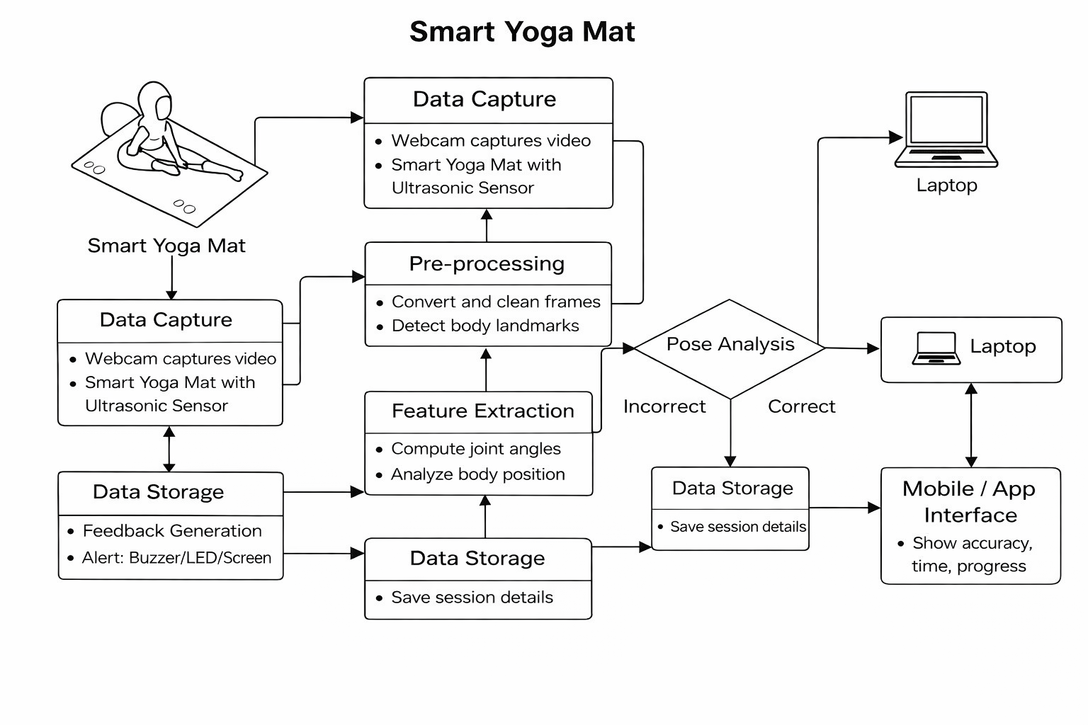
METHODOLOGY
Fig. 1: System Architecture of Smart Yoga Mat Using IoT

Slide 9
RESULTS & DISCUSSIONS
The system successfully detects full body yoga posture using webcam input.
MediaPipe pose estimation identifies body landmarks for posture analysis.
Joint angles are calculated to determine whether the pose is correct or incorrect.
When incorrect posture is detected, the system provides screen alerts and voice feedback.
The results show that the Smart Yoga Mat helps users practice yoga correctly at home.

Slide 10
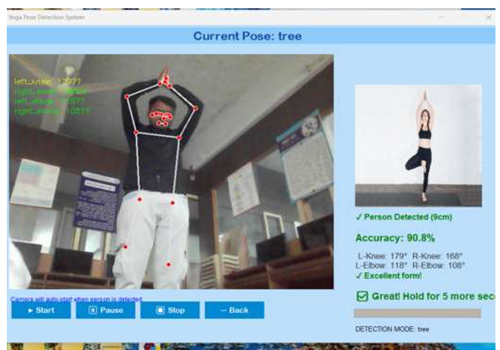
RESULTS & DISCUSSIONS
Fig. 2: Smart Yoga Mat System Output Interface

Slide 11
CONCLUSIONS & FUTURE SCOPE
Conclusion:
The Smart Yoga Mat Using IoT helps users practice yoga with better posture accuracy.
It monitors body alignment, balance, and session duration using sensors and software.
The system provides real-time feedback through a laptop application.
It improves safety, effectiveness, and consistency in home-based yoga practice.
Future Scope:
Integration of Artificial Intelligence for personalized yoga training.
Development of a mobile application for easier access.
Support for more yoga poses and exercise types.
Expansion for physiotherapy and rehabilitation exercises.
ICETIS-2026, DACOE, Karad,

Slide 12
REFERENCES
[1] Long, J., & Jo, K. (2020) : Development of Yoga Posture Coaching System using Transfer Learning Approach. IEEE Access, 8, 195–204.
[2] Sun, W. (2021) : RFitness: Enabling Smart Yoga Mat for Fitness Posture Detection with Commodity Passive RFIDs. Sensors Journal, 21(4), 123–132.
[3] Gadhvi, R., Desai, P., & Siddharth (2023) : PosePilot: An Edge-AI Solution for Posture Correction in Physical Exercises. arXiv Preprint, 1–10.
[4] Sharma, A., Sharma, P., Pincha, D., & Jain, P. (2022) : Computer Vision-Based Yoga Pose Recognition using CNN and Mediapipe. International Journal of Computer Vision Applications, 15(2), 45–55.
[5] Anusha, M., Dubey, S., Raju, P.S., & Pasha, I.A. (2021) : Real-Time Yoga Activity with Assistance of Embedded-Based Smart Yoga Mat. International Journal of Embedded Systems, 12(3), 89–97.

